Slide 1

Using Actor-Partner Interdependence Models (APIM) to explore indistinguishable and distinguishable dyads with Multilevel (MLM) & Structural Equation Modeling (SEM) approaches.
Facilitators: Prof. C. Binnewies & Prof. G. Michaelides
June 18, 2026 — University of Helsinki
Slide 1 / 32
Slide 1 / 32

Slide 2





EAOHP 2026 WORKSHOP • OVERVIEW
Slide 2 / 32
Workshop Structure Overview
01. Foundations
02. Indistinguishable
03. Distinguishable
04. Advanced Topics
Understand dyadic dependencies, assumptions, key APIM parameters, and structural distinguishability.
Evaluate systemic roles (e.g. gender, hierarchy) using moderator, two-intercept, and multi-group SEM variations.
Model exchangeable partners using Multilevel Modeling (lme4) and SEM equality constraints.
Address moderated crossover, diary designs, sample size guidelines, and missing data using FIML.
Slide 2 / 32
Slide 2 / 32

Slide 3

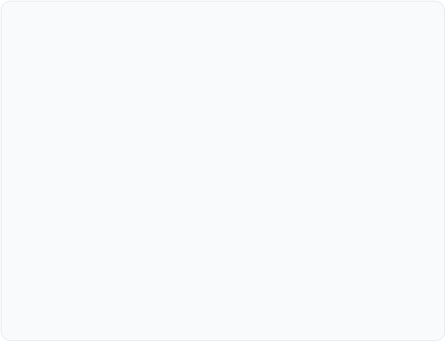
EAOHP 2026 WORKSHOP • FOUNDATIONS
Slide 3 / 32
What Is Dyadic Data?
Dyadic data arise when observations are gathered in pairs (dyads) that demonstrate systematic interdependence. Common examples include:
Simulated Workshop Dataset
Romantic Couples: Partners in heterosexual or same-sex relationships (often distinguishable).
We utilize a double-earner dataset styled after Hahn, Binnewies, & Dormann (2014, JVB):
Workplace Dyads: Supervisor-subordinate, mentor-mentee configurations.
Sample Size: N = 100 couples (200 unique individuals)
Focal Predictor (X): Work-Nonwork Connection (WNC)
Parent-Child Pairs: Mothers & daughters, fathers & sons.
Secondary Covariate (Z): Psychological Recovery
Peer Groups: Roommates, sports teammates, co-workers.
Target Outcome (Y): Relationship Satisfaction
Non-independence violates classic OLS regression assumptions, leading to biased standard errors and highly inflated Type I error rates.
Nesting Indices: Gender, children indicators
Slide 3 / 32
Slide 3 / 32

Slide 4

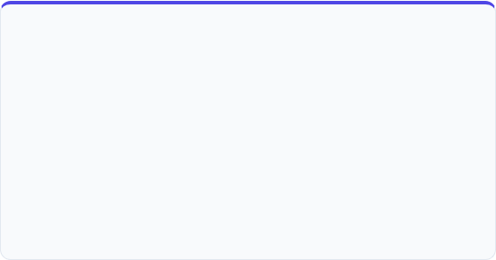

EAOHP 2026 WORKSHOP • EXERCISES
Slide 4 / 32
Workshop Exercises
An independent simulated dataset for practising crossover-of-work-outcomes techniques on a coherent research question.
Research Scenario
Dataset Specification
How does a partner’s affect, self-determination, and job crafting crossover to shape an actor’s work outcomes?
N = 250 dual-earner dyads (500 individuals)
• Gender: male / female
• ICC(1) predictors ≈ 0.30
Files: exercise_data.Rdata ddl2 (long), ddw2 (wide)
Predictors: actor & partner affect, SDT, job crafting
Outcomes: engagement, performance, creativity
Moderators: live together, years together, time spent this morning
Focal crossovers:
partner job crafting x live_together -> engagement
partner SDT x years_together -> performance
partner affect x time spent -> creativity
Slide 4 / 32
Slide 4 / 32

Slide 5
EAOHP 2026 WORKSHOP • EXERCISES
Slide 5 / 32
Exercises & Answer Template
A guided, prose-only workflow for adapting scripts 02-08 to the exercise dataset - emphasis on interpretation, not copy-paste.
exercises/exercises.md
exercises/answers_template.R
9 sections mirroring scripts 02-08 + integrative Section 9.
How to use the template:
1. Run simulate_exercise_data.R to load data
2. Read exercises.md section by section
3. Open answers_template.R alongside each script
4. Apply the substitution table to map data to scripts
5. Write a 1-sentence interpretation as a comment
Sections 1-3: scripts 02-04 (APIM, multilevel, distinguishable)
Sections 4-6: scripts 05-07 (distinguishable SEM, two-intercept)
Section 9: integrative reflection across all models on the exercise dataset
Slide 5 / 32
Slide 5 / 32

Slide 6

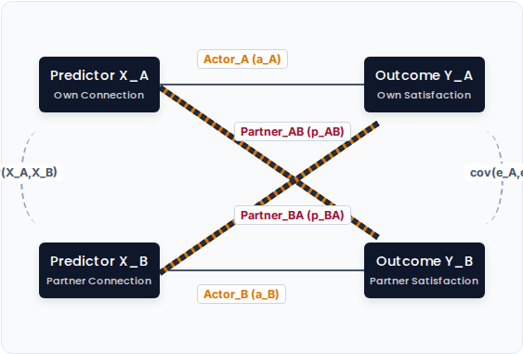
EAOHP 2026 WORKSHOP • FOUNDATIONS
Slide 6 / 32
The APIM Framework
The **Actor-Partner Interdependence Model** (Kenny, Kashy, & Cook, 2006) resolves dyadic dependencies by estimating individual pathways simultaneously:
Actor Effects (a): The influence of your own predictor status on your own target outcome (e.g. Own connection → Own satisfaction).
Partner Effects (p): The interpersonal crossover of your partner's predictor on your outcome (e.g. Partner's connection → Own satisfaction).
Simultaneous Control: Modeling actor and partner paths together extracts true cross-partner influence while isolating individual biases.
Slide 6 / 32
Slide 6 / 32

Slide 7

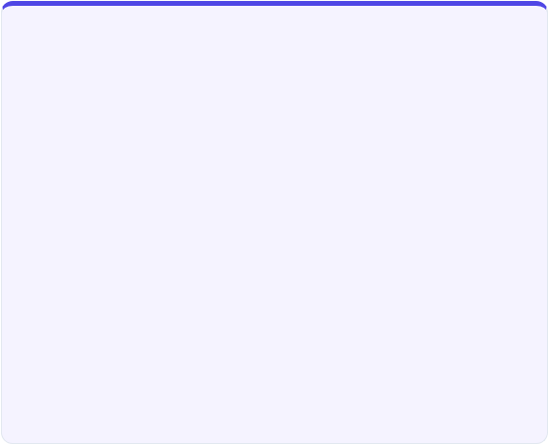
EAOHP 2026 WORKSHOP • FOUNDATIONS
Slide 7 / 32
Indistinguishable vs. Distinguishable
Indistinguishable Dyads
Distinguishable Dyads
Members are exchangeable. No baseline or stable structural variable differentiates them.
Members can be classified using a systematic, theoretical variable that is consistent across the sample.
Arbitrary Labels: Partner labels (e.g. A vs B, Left vs Right) are completely interchangeable.
Systematic Labels: Partners are labeled using a meaningful criterion (e.g. Wife/Husband, Boss/Employee).
Equality Constraints: Actor and partner slopes must be constrained to be mathematically equal across partners.
Typical Examples: Same-sex roommates, co-workers of equal organizational rank, sibling pairs.
Typical Examples: Heterosexual couples, medical caregiver-patient dyads, manager-employee pairs.
Important: Indistinguishability is an empirical hypothesis. Always test it formally (by comparing a constrained model with an unconstrained version) before locking in equal-parameter constraints!
Slide 7 / 32
Slide 7 / 32

Slide 8
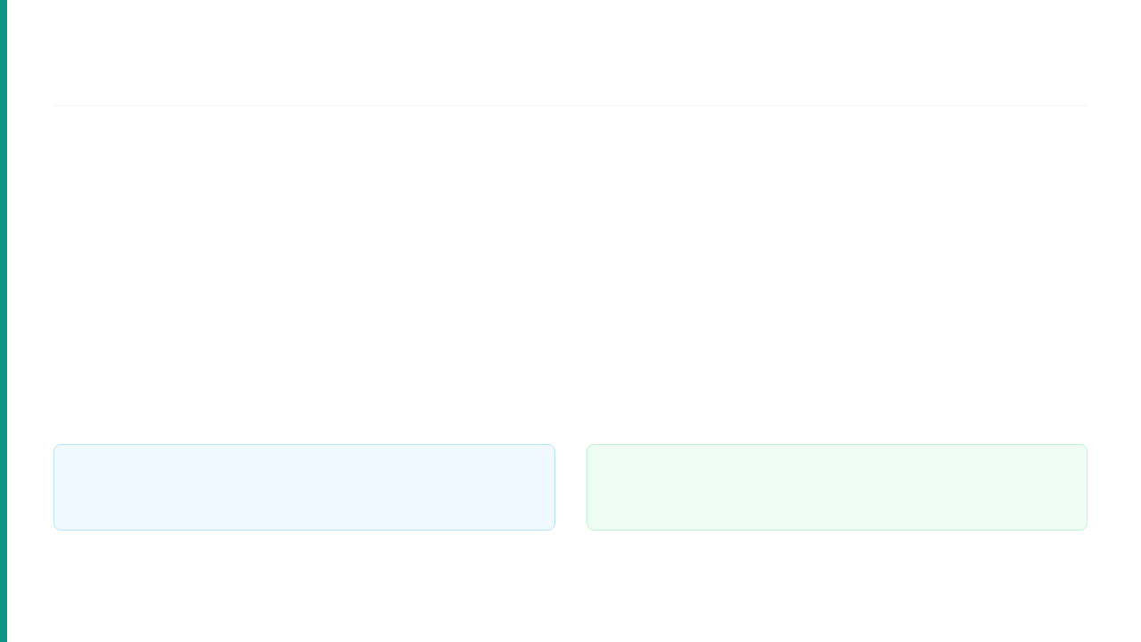

EAOHP 2026 WORKSHOP • FOUNDATIONS
Slide 8 / 32
Modeling Options Taxonomy
Choose the optimal modeling combination based on your data layout, distinguishability, and nested structures:
Modeling Strategy | Analytical Framework | Data Layout | Core Application & Mechanism
Indistinguishable APIM | MLM (e.g., lme4) | Long Format | Symmetric pooling of slopes across members; simple intercept ICC check.
Moderated MLM APIM | MLM (e.g., lme4) | Long Format | Incorporates member interactions directly into continuous pathways.
Two-Intercept MLM APIM | MLM (e.g., lme4) | Long Format | Suppresses overall intercept to map distinct group means simultaneously.
Standard SEM APIM | SEM (e.g., lavaan) | Wide Format | Strict parameter constraints, goodness-of-fit indices, FIML for missing data.
Multilevel SEM (MSEM) | MSEM (e.g., lavaan) | Long (Nested) | Simultaneous latent variables and complex nesting within nested arrays.
Framework Choice: MLM models excel at complex nesting patterns, daily diaries, and unbalanced structures. SEM provides fit indices, simultaneous constraints, and mediation tests.
Specification Tip: Wide-format SEM allows testing of complex, non-linear partner spillover parameters and structural residuals that are difficult to write in traditional MLM notation.
Slide 8 / 32
Slide 8 / 32

Slide 9

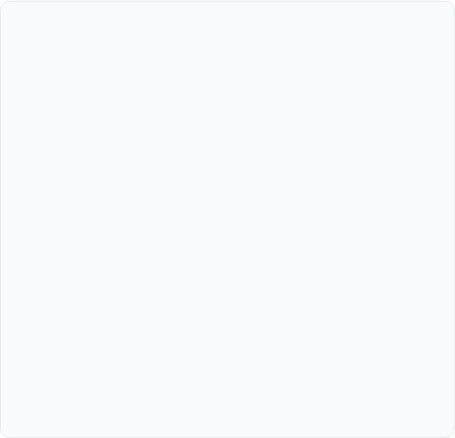
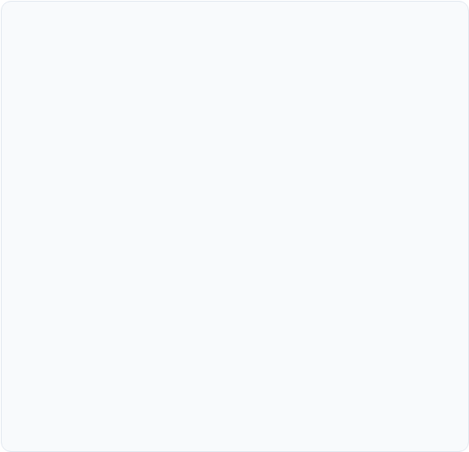


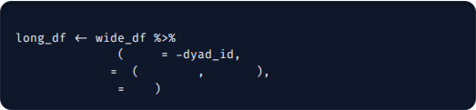
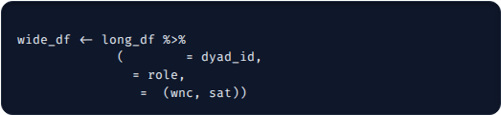
EAOHP 2026 WORKSHOP • INDISTINGUISHABLE
Slide 9 / 32
Reshaping Dyadic Data
Wide Format (1 Row/Dyad)
Long Format (2 Rows/Dyad)
Standard for SEM with suffix variable labels mapping to specific roles.
Standard for MLM with repeated observations nested within a single key.
dyad_id | wnc_a | wnc_p | sat_a | sat_p
101 | 4.2 | 3.8 | 5.1 | 4.9
102 | 3.1 | 3.2 | 4.8 | 4.7
dyad_id | role | wnc | sat
101 | person_1 | 4.2 | 5.1
101 | person_2 | 3.8 | 4.9
102 | person_1 | 3.1 | 4.8
102 | person_2 | 3.2 | 4.7
# Reshape from Wide to Long
# Reshape from Long to Wide
pivot_longer
cols
pivot_wider
id_cols
names_to
c
".value"
"role"
names_from
names_sep
"_"
values_from
c
Slide 9/ 32
Slide 10 / 32

Slide 10

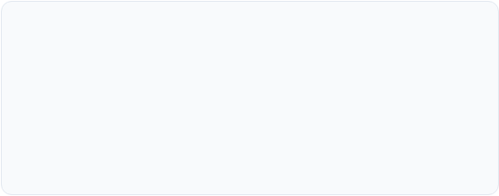

EAOHP 2026 WORKSHOP • INDISTINGUISHABLE
Slide 10 / 32
Multilevel Modeling (Long Format)
To handle indistinguishable datasets, format the file in long format (one row per person, two rows per dyad). Random effects adjust for nested interdependence.
MLM Formulation
Empty Intercept-Only Model: Compute the Intra-class Correlation (ICC) to estimate the proportion of shared variance.
Where i represents the individual, j represents the dyad, u_j represents the dyad-level random intercept, and e_ij is individual residual.
Model Specification: Estimate both actor and partner paths symmetrically, pooling slope estimators across the dyad members.
Centering Strategy: Group-mean center independent variables to cleanly separate within-dyad from between-dyad effects.
Requires the lme4 package in R for model fitting, and lmerTest to compute Satterthwaite degrees of freedom.
Slide 10 / 32
Slide 9 / 32

Slide 11

EAOHP 2026 WORKSHOP • INDISTINGUISHABLE
Slide 11 / 32
R Code: Indistinguishable MLM
We estimate the basic APIM framework step-by-step using lmer. Ensure your package environment is properly configured:
# Indistinguishable MLM (script 02)
library(lme4); library(lmerTest)
load("dyad_data.RData")
# 1. Null model + ICC
m0 <- lmer(sat ~ 1 + (1 | dyad), data=ddl)
icc(m0) # between / (between + residual)
# 2. Full APIM
m1 <- lmer(sat ~ wnc + partner_wnc +
recovery + has_children +
dual_earner + (1 | dyad), data=ddl)
summary(m1)
Loads data in long format (one row per partner).
Calculates the **ICC** to verify within-dyad correlation.
Includes covariates: Recovery, Children status, and Dual-Earner category.
Note: In indistinguishable setups, slope estimates are pooled across groups.
Slide 11 / 32

Slide 12

EAOHP 2026 WORKSHOP • INDISTINGUISHABLE
Slide 12 / 32
Hands-On: Indistinguishable MLM
Active Code Session
Let's execute your first multilevel APIM scripts in RStudio:
Open: scripts/02_indistinguishable_mlm.R
Run: Estimate the null model and compute the ICC: ICC = σ²_between / (σ²_between + σ²_residual)
Run the full APIM
Slide 12 / 32
Slide 12 / 32

Slide 13
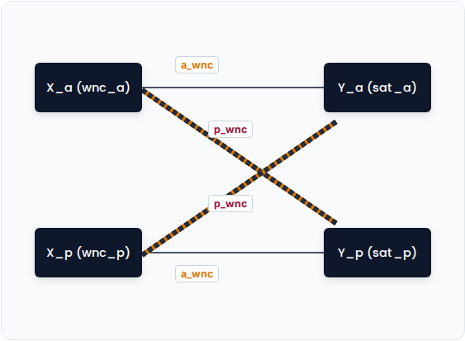
EAOHP 2026 WORKSHOP • INDISTINGUISHABLE
Slide 13 / 32
Structural Equation Modeling
We specify explicit path lines inside wide-format data (one row per dyad with distinct suffix labels _a / _p). Equality constraints are declared to enforce indistinguishability:
Slope Constraints: Own paths (b_a) and partner paths (b_p) are labeled identically.
Interceptions/Variances: Model intercepts, variances, and residuals are restricted to equality.
Slide 13 / 32
Slide 13 / 32

Slide 14
EAOHP 2026 WORKSHOP • INDISTINGUISHABLE
Slide 14 / 32
R Code: Indistinguishable SEM
We write structural code using lavaan syntax. Suffix tags label identical parameters across equations to enforce symmetry:
# Indistinguishable SEM wide (script 03)
library(lavaan)
mod_c <- '
sat_a ~ a_wnc*wnc_a + p_wnc*wnc_p +
a_rec*rec_a + p_rec*rec_p +
c_ch*child + c_du*dual_earner
sat_p ~ a_wnc*wnc_p + p_wnc*wnc_a +
a_rec*rec_p + p_rec*rec_a +
c_ch*child + c_du*dual_earner
sat_a ~ alpha*1
sat_p ~ alpha*1 # equal intercepts
sat_a ~~ var_res*sat_a
sat_p ~~ var_res*sat_p # equal residuals
'
fit <- sem(mod_c, data=ddw)
Label Syntax: Prefixing coefficients with label names (e.g. a_wnc*wnc_a) forces equality.
Interceptions & Variances: Restricting intercepts (alpha*1) and residuals (var_res*sat_a) establishes full indistinguishability.
Slide 14 / 32

Slide 15
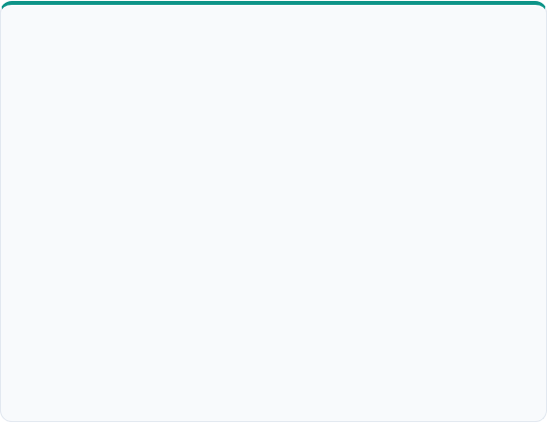
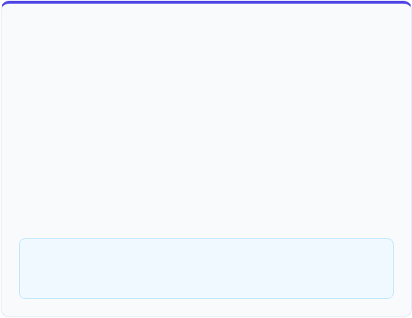
EAOHP 2026 WORKSHOP • INDISTINGUISHABLE
Slide 15 / 32
Hands-On: Indistinguishable SEM
Active Coding Session
Questions to Explore
Let's transition from multilevel modeling to structural equation modeling:
Compare the parameter values from Model A (cluster-robust) with Model B (two-level SEM) to Model C (wide-format constraint).
Open: scripts/03_indistinguishable_sem.R
Evaluate: Review the three alternative analytical paradigms defined in the script:
Model A: Cluster-robust Standard Errors (quick, long format)
Model B: Two-level SEM (within/between decomposition)
Model C: Wide-format APIM (primary, with full equality constraints)
How does structural estimation impact statistical precision in small-to-medium samples?
Slide 15 / 32
Slide 15 / 32

Slide 16



EAOHP 2026 WORKSHOP • INDISTINGUISHABLE
Slide 16 / 32
Core Analytical Insights
Method Convergence
LRT Testing
Analytical Trade-offs
Balanced data profiles yield identical point estimates in both **Multilevel (long)** and **SEM (wide with equal constraints)** designs.
Perform a Chi-Square Difference Test comparing the fully constrained model with an unconstrained version to empirically test for indistinguishability.
Why choose SEM over Multilevel for indistinguishable dyads?
Supports multi-item latent variables.
FIML retains dyads with partial missing values.
Supports full mediation models.
Slide 16 / 32
Slide 16 / 32

Slide 17


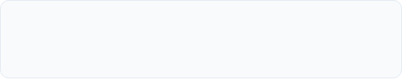
EAOHP 2026 WORKSHOP • DISTINGUISHABLE
Slide 17 / 32
Moderator Interaction Modeling
When dyad members are distinguishable (e.g. heterosexual couples), we can model interactions between predictors and the grouping factor (e.g. gender) in long format.
Warning for crossover effects
Simple moderator setups (Version A) conflate actor and partner pathways. This can lead to misleading conclusions when evaluating crossover effects.
Version A: Simple Moderator (Conflated)
Always specify the **Full APIM Moderator** (Version B) to properly separate actor from partner pathways when using the moderator approach in long format.
Version B: Full APIM Moderator (Decomposed)
Slide 17 / 32

Slide 18
EAOHP 2026 WORKSHOP • DISTINGUISHABLE
Slide 18 / 32
R Code: Moderator MLM
We write the interaction script for Version B using lmer. This model evaluates if actor and partner effects differ significantly by gender:
# Distinguishable: MLM Moderator (script 04)
library(lme4); library(lmerTest)
load("dyad_data.RData")
# Baseline (no interactions)
m_base <- lmer(sat ~ wnc + partner_wnc +
rec + p_rec + child + dual +
(1 | dyad), data=ddl)
# Full APIM with gender interactions
m_mod <- lmer(sat ~ wnc*gender +
partner_wnc*gender + rec +
p_rec + child + dual +
(1 | dyad), data=ddl)
summary(m_mod)
anova(m_base, m_mod)
Reference Group: Male is set as the reference group (simple slope = b_wnc).
Interaction Term: Estimates the difference in slopes (female simple slope = b_wnc + b_wnc:genderfemale).
See script 04
Slide 18 / 32

Slide 19
EAOHP 2026 WORKSHOP • DISTINGUISHABLE
Slide 19 / 32
Hands-On: Moderator APIM
Active Coding Session
Theoretical RQ Example
Let's practice modeling interaction terms in distinguishable dyads:
"Does gender moderate the crossover of work-family connection between spouses, such that the crossover effect of partner connection on relationship satisfaction is stronger for females than for males?"
Open: scripts/04_distinguishable_mlm.R
Analyze: Fit the full APIM moderator interaction model in R.
Evaluate: Identify the interaction terms: wnc:genderfemale and partner_wnc:genderfemale. Calculate the simple slopes for males and females.
Are the simple slopes statistically significant for both males and females?
Slide 19 / 32

Slide 20

EAOHP 2026 WORKSHOP • DISTINGUISHABLE
Slide 20 / 32
The Two-Intercept Model
To avoid setting an arbitrary reference group (like males), we can suppress the global intercept using the 0 + gender syntax.
Three Modeling Stages
Direct Parameterization: Directly estimates intercepts and slopes for both males and females, simplifying group comparisons.
Compare these nested models using Likelihood Ratio Tests:
Model 1: Equal intercepts, equal slopes (most constrained model).
Model 2: Different intercepts, equal slopes (recommended baseline model).
Flexible Equality Constraints: Easily constrain slopes to be equal across groups while still estimating separate intercepts.
Model 3: Different intercepts, gender-varying slopes (full interaction model).
Slide 20 / 32
Slide 22 / 32

Slide 21
EAOHP 2026 WORKSHOP • DISTINGUISHABLE
Slide 21 / 32
R Code: Two-Intercept MLM
The two-intercept model is specified in lme4 by suppressing the global intercept (using 0 + gender) so each group gets its own intercept:
# Two-Intercept MLM (script 05)
library(lme4); library(lmerTest)
load("dyad_data.RData")
# Equal slopes, separate intercepts
m2 <- lmer(sat ~ 0 + gender + wnc +
partner_wnc + rec + p_rec +
child + dual_earner +
(1 | dyad), data=ddl)
summary(m2)
# Coefficients: gendermale, genderfemale
# are the two dyad-member intercepts
Interpretable Outputs: Coefficients are presented as separate intercepts (gendermale, genderfemale) rather than standard difference offsets.
Nested Model Comparisons: Compares nested model equations to identify distinct parameter slopes.
See script 05
Slide 21 / 32

Slide 22
EAOHP 2026 WORKSHOP • DISTINGUISHABLE
Slide 22 / 32
Distinguishable: SEM Moderator
The Approach
lavaan Model
Mirror the lme4 gender moderator (script 06) as a two-level lavaan model. Gender interactions enter at the within-dyad level; dyad-level covariates (children, dual earner) at the between level.
Two-level SEM: gender interactions are placed at the within-dyad level. Numeric coding (1=male, 2=female) makes the simple-slope labels explicit:
ss_wnc_M := a_w + aw_int * 1
ss_wnc_F := a_w + aw_int * 2
Tip: Models are saturated at the within level, so chi-square difference tests are not available. Use simple-slope labels (:=) to interpret the moderation.
Slide 22 / 32

Slide 23
EAOHP 2026 WORKSHOP • DISTINGUISHABLE
Slide 23 / 32
R Code: SEM Moderator
# SEM Moderator (script 06)
library(lavaan)
ddl$gender_num <- as.numeric(ddl$gender)
ddl$wnc_x_g <- ddl$wnc * ddl$gender_num
ddl$pw_x_g <- ddl$partner_wnc * ddl$gender_num
mod <- '
level: within
sat ~ a_w*wnc + p_w*partner_wnc +
ar_w*recovery + pr_w*partner_recovery +
g_w*gender_num +
aw_int*wnc_x_g + pw_int*pw_x_g
level: between
sat ~ c_ch*has_children + c_du*dual_earner
# Simple slopes
ss_wnc_M := a_w + aw_int * 1
ss_wnc_F := a_w + aw_int * 2
'
fit <- sem(mod, data=ddl, cluster="dyad_id")
summary(fit)
Two-Level SEM with Gender Moderation
We construct a two-level lavaan model that mirrors the lmer interaction (script 06):
Slide 23 / 32
Slide 21 / 32

Slide 24
EAOHP 2026 WORKSHOP • DISTINGUISHABLE
Slide 24 / 32
Distinguishable: SEM (lavaan)
In structural equation modeling, distinguishable dyads are modeled using wide-format datasets. We can estimate separate slopes, variances, and covariances for each group without constraints:
# Distinguishable SEM wide (script 07)
library(lavaan)
# Three nested models:
# 1) Unconstrained - all paths free
# 2) Slopes equal - labels a,p,...
# 3) Fully equal - + equal intercepts
mod_un <- '
sat_a ~ a_h*wnc_a + p_h*wnc_p + ...
sat_p ~ a_w*wnc_p + p_w*wnc_a + ...
sat_a ~ int_a*1
sat_p ~ int_p*1 # separate intercepts
'
fit_un <- sem(mod_un, data=ddw)
lavTestLRT(fit_un, fit_slopes,
fit_full) # nested LRTs
Unconstrained Baseline: Establishes unique pathways (e.g. males: a_m, females: a_f).
Nested Constraints: Constrain slopes to be equal (e.g. a == a) to test for gender differences via a Chi-Square Difference Test.

Slide 25
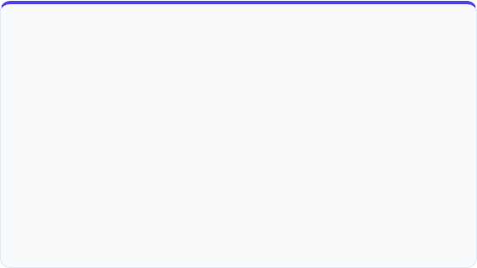

EAOHP 2026 WORKSHOP • DISTINGUISHABLE
Slide 25 / 32
Hands-On: Distinguishable SEM
Active Coding Session
Core Modeling Decisions
Let's practice setting constraints in structural equation models:
"If the Chi-Square Difference Test is non-significant, adopt the constrained model for parsimony. If significant, retain the unconstrained model to allow for gender differences."
Open: scripts/06_distinguishable_sem_wide.R
Execute: Fit the unconstrained, slopes-equal, and fully-equal (slopes + intercepts) models.
Compare: Run Chi-Square Difference Tests comparing the three models to determine if constraining male and female slopes to be equal significantly worsens model fit.
Does model fit change significantly?
Slide 25 / 32
Slide 25 / 32

Slide 26

EAOHP 2026 WORKSHOP • DISTINGUISHABLE
Slide 26 / 32
Distinguishable: Model Comparison
Compare the three primary structural modeling methods used for distinguishable dyad analyses:
Feature | Moderator Approach (lme4) | Two-Intercept (lme4) | SEM Approach (lavaan)
Data Format | Long Format (One row/person) | Long Format (One row/person) | Wide Format (One row/dyad)
Intercepts | Reference Group + Offset | Two Direct Intercepts | Two Direct Intercepts
Testing Slope Differences | Via Interaction Significance | Via Likelihood Ratio Test | Via Chi-Square Difference
Fit Indices | No (relies on log-likelihood) | No (relies on log-likelihood) | Yes (CFI, RMSEA, AIC/BIC)
Missing Data | Listwise Deletion | Listwise Deletion | FIML (retains partial dyads)
Best Application | Testing external continuous moderators | Direct means comparisons | Complex mediation & latent vars
Slide 26 / 32
Slide 26 / 32

Slide 27

EAOHP 2026 WORKSHOP • MODERATED APIM
Slide 27 / 32
The Buffer Hypothesis
We replicate the theoretical model of **Hahn, Binnewies, & Dormann (2014)** to examine if dyad-level moderators alter standard APIM pathways:
Moderated APIM Structure
The model includes interaction terms between the **Partner Connection** predictor and the **Has Children** indicator.
Research Question: Does the presence of children moderate the partner crossover effect (Partner Connection → Own Satisfaction)?
Theoretical Mechanism: Partner crossover represents stress transmission. Joint domestic demands (e.g. child-rearing) may alter these crossover pathways.
Findings: The crossover effect is buffered (weaker) for couples with children, as shared family responsibilities alter cognitive work-life boundaries.
Both MLM and SEM frameworks can accommodate dyad-level moderators.
Slide 27 / 32
Slide 27 / 32

Slide 28

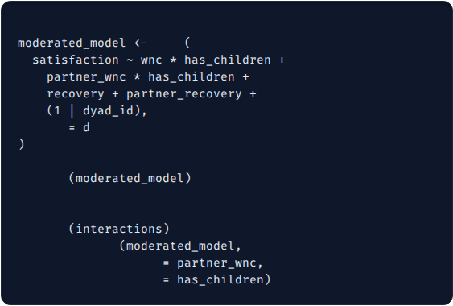
EAOHP 2026 WORKSHOP • MODERATED APIM
Slide 28 / 32
Multilevel vs. SEM Formulations
We estimate the interaction using either lme4 or lavaan:
# Moderated APIM, MLM (script 08)
library(lme4); library(lmerTest); library(interactions)
m_mod <- lmer(satisfaction ~ wnc + partner_wnc +
has_children +
wnc:has_children + partner_wnc:has_children +
(1 | dyad_id), data = ddl)
interact_plot(m_mod, pred = partner_wnc, modx = has_children)
# *** SEM: lavaan ***
# SEM Approach: lavaan (script 08)
ddw$wnc_a_children <- ddw$wnc_a * ddw$has_children
ddw$wnc_p_children <- ddw$wnc_p * ddw$has_children
mod <- '
sat_a ~ a*wnc_a + p*wnc_p + a_int*wnc_a_children
sat_p ~ a*wnc_p + p*wnc_a + p_int*wnc_p_children
actor_no_child := a + a_int * 0
actor_has_child := a + a_int * 1
'
fit <- sem(mod, data = ddw)
summary(fit)
lme4 Interaction: wnc * has_children + partner_wnc * has_children
lavaan Interaction: Requires creating manual product indicators for the interactions in wide format before fitting.
Open: scripts/08_moderated_apim.R. Run the script and plot the interaction slopes.
Slide 28 / 32
Slide 28 / 32

Slide 29

EAOHP 2026 WORKSHOP • ADVANCED
Slide 29 / 32
Advanced: APIM Power Analysis
Dyadic power analysis is complex because power is a function of the **Intra-class Correlation (ICC)**, effect size, and the number of dyads (not individuals).
Sample Requirements Metric
α = 0.05, power = 0.80 — required N (dyads):
Basic APIM: Requires a minimum of 50 dyads; N = 100-120 dyads is preferred.
Effect size (β) | β = .15 | β = .25
Indistinguishable dyads | 159 | 59
Distinguishable dyads | 348 | 129
Partner Effects: Require larger samples than actor effects due to shared variance.
Moderation: Cross-level interactions typically require N > 150 dyads.
Estimated with APIMPowerR:
https://robert-a-ackerman.shinyapps.io/APIMPowerRdis/
Slide 29 / 32
Slide 29 / 32

Slide 30

EAOHP 2026 WORKSHOP • ADVANCED
Slide 30 / 32
Three-Level Nesting Structures
Dyads are often nested within larger clusters (e.g. organizations, departments, clinic teams), or measured over time:
Bayesian Estimations
3-Level syntax in lme4: satisfaction ~ wnc + (1 | team_id) + (1 | dyad_id)
For small samples or complex models with multiple random slopes, Bayesian estimations provide stable parameter estimates:
Daily Diary / ESM Designs: Days nested within Persons, nested within Dyads.
brms: Stan-based package with intuitive, lme4-like syntax.
Allows modeling of daily actor/partner lag fluctuations.
Time-lagged effects: Does yesterday's connection predict today's relationship satisfaction?
blavaan: Fits Bayesian SEM models.
Slide 30 / 32
Slide 30 / 32

Slide 31

EAOHP 2026 WORKSHOP • SUMMARY
Slide 31 / 32
Missing Data in Dyadic Designs
If one partner has missing data, listwise deletion in standard regression removes the entire dyad. This significantly reduces statistical power:
SEM FIML: Full Information Maximum Likelihood estimates parameters using all available data under MAR assumptions. This is the preferred approach.
.
Multiple Imputation: Impute missing values at the dyad level using packages like mice to preserve dyadic dependencies.
Slide 31 / 32
Slide 31 / 32

Slide 32

EAOHP 2026 WORKSHOP • SUMMARY
Slide 32 / 32
Questions & Discussion
Thank You!
We have successfully walked through the foundations, estimations, and advanced extensions of the Actor-Partner Interdependence Model (APIM) in R.
R Workspace Datasets & Scripts: Check the local scripts/ directory to run exercises.
Slide 32 / 32
Slide 32 / 32

